Slide 1
Quantum Resource Estimation of the Quantum Approximate Optimization Algorithm (QAOA)
QRISE2024
Microsoft Challenge

Slide 2





Team - Qu-Cats “We are not dead yet”
Katie Harrison
Muhammad Waqar
Nikhil Londhe
Sarah Dweik

Slide 3

Contents
Project Selection
QAOA in Q#
Results & Discussion
Conclusion/Next steps
References

Slide 4
Project Selection
QAOA shows promise for improving the runtime of Quadratic Unconstrained Binary Optimization problems that are NP
Little prior exploration: Our study uniquely emplys Microsoft’s Estimator to predict resources for QAOA implementation on quantum computers[].
Learning opportunity

Slide 5
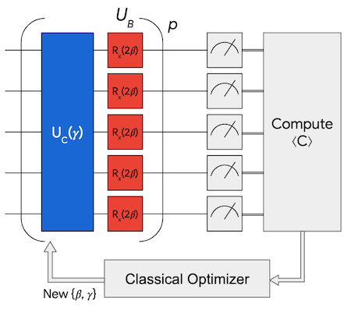
Quantum Approximate Optimization Algorithm (QAOA)
QAOA [2] is an Quantum Algorithm to solve combinatorial optimization problems.
Draws inspiration from the Adiabatic Theorem.
High level Overview:
Prepare a quantum state that encodes all potential solutions.
Evolve the state using 𝙥 layers.
Tune the adjustable parameters (𝞫 and 𝞬) using an optimizer to find the optimal solution.
Image Ref - Google Quantum AI - QAOA example problems
Notes:
QAOA is a hybrid Quantum Algorithm that is use to solve combinatorial optimization problems.
It is based on the Adiabatic theorem which in its original form states that a physical system will remain in the instantaneous eigenstate if the perturbation is slow enough and if there is a gap between the eigenvalue and the rest of the Hamiltonian's spectrum.
QAOA is designed to solve QUBO problems, so any problem that can be formulated/embedded as QUBO can be solved by QAOA. QUBO shares a special connection to Ising models as any QUBO is computationally equivalent to Ising models.A notable example of QUBO formulation is MAXCUT.
It is important to note that QAOA provides approximate solutions.
High level Overview:
Prepare a quantum state that encodes all the possible solutions
Evolve the state using p layers of cost and mixer layer
Tune/Optimize the parameters gamma and beta to find the minimum expectation value and hence the optimal solution.
If time permits:
QAOA, ideally can provide optimal solutions for p (layers) -> infinity but in practice can only provide approximate solutions.
QAOA is a special case of Variational Quantum Eigensolver (VQE)
QAOA can be thought as the trotterized version of the Quantum Adiabatic Algorithm (QAA).

Slide 6
QAOA using Q# and Python
Formulate the optimization problem as a QUBO.
Input the coefficients from QUBO and run the circuit. (Q#)
Using the results of the QAOA circuit optimize the parameters using an optimizer (COBYLA).
Run the QAOA circuit with optimal parameters to get the solution.
Python
Q#
We tested our implementation by solving the Number Partition Problem
Image Ref - Google Quantum AI - QAOA example problems
Notes:
To run QAOA we need to go through the following steps:
We need to express our problem as QUBO. This corresponds to mapping our objective as a cost function in the QUBO form. This is usually in the form of a minimization problem (for maximization add -ve sign).
Encode the coefficients (gotten form QUBO) into the QAOA circuit and run the circuit. (This circuit simulation is carried out by Q#)
Use an optimizer to optimize the parameters gamma and beta such that the expectation value is minimized.
Once the optimizer gives us optimal parameters we can the QAOA circuit to get the optimal solution.
We tested our implementation on the NPP problem.
If time permits:
Number Partition Problem:
Given a list of integers A partition the list into S and S/A so that difference in sum of S and S/A is minimal.

Slide 7
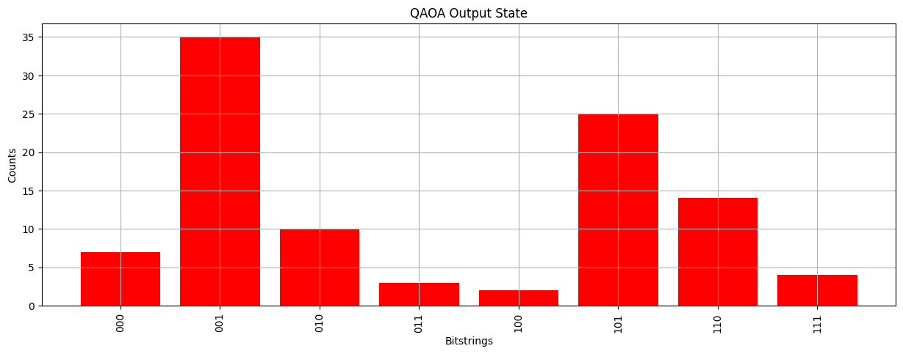
We tested our implementation by solving the Number Partition Problem with an input of [1,5,6]
[1,5,6]:
001 = [1,5],[6]

Slide 8
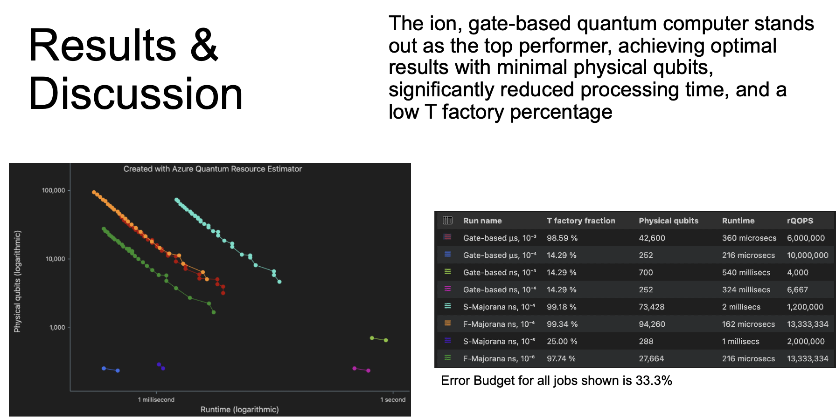
Notes:
(After Conducting a lengthy literature review, choosing the umbrella term of problems that fall under QUBO(quadratic unconstrained Binary Optimizer) and then narrowing our topic to number partitioning specifically, we then proceeded to learn how to and then code our algorithm in Q#.)
Once we encoded and tested our QAOA circuit and classical optimizer worked to our satisfaction, we proceeded to apply Microsoft’s Resource Estimator Algorithm to our QAOA Circuit (quantum representation of the number partition problem) to determine the number and of resources needed to compute the quantum circuit and to determine the configuration of parameters that would give us the highest chance of success, while requiring the fewest resources.
Our first step was to run and compare the various combinations of qubit types and error correction schemes
at this step we had a total of 8 jobs, 3 different system setups including ion qubits, superconducting qubits, and Majorana qubits. for each system we ran a 1 job that computed a realistic and 1 job that computed the optimistic error rate target.
all Gate_Based jobs were run using the “surface_code” quantum error correction scheme, and the Majorana based qubits explored both a surface and Floquet error correction scheme.
The graph shown here was made using Azure Quantum’s Estimate Overview function, all the values you see were measured with an error budget of 33.3%
The job that stands out as the best performer is the Gate_based ion quantum computer with an optimistic 14.29% T Factory Fraction percentage, 252 physical qubits, a runtime of 216 microsecs, and a rQOPS of 10 million
To confirm that this was a good option we moved onto phase two of analysis. Examining our error budget (next slide)
(if time permits add: we chose to start 33% as our error Budget threshold because of 2 reasons. number 1. we wanted to give every a chance to show their best possible outcome, we can always do more error correction later. reason number 2. our solution only has about a 35-50% success rate, but that is good enough to get the right answer.)

Slide 9
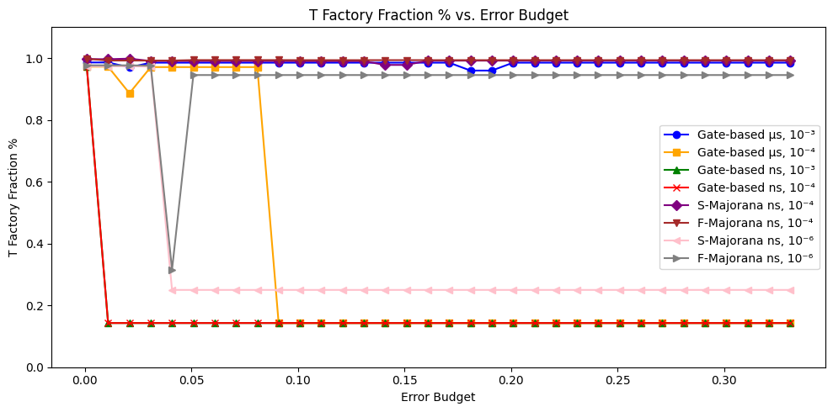
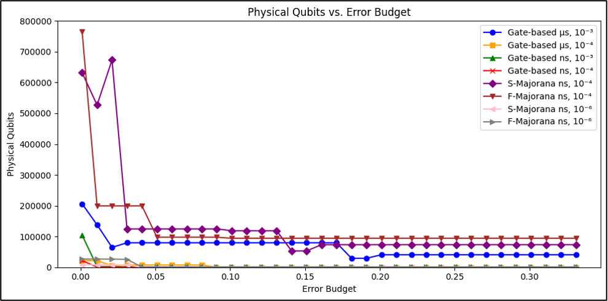
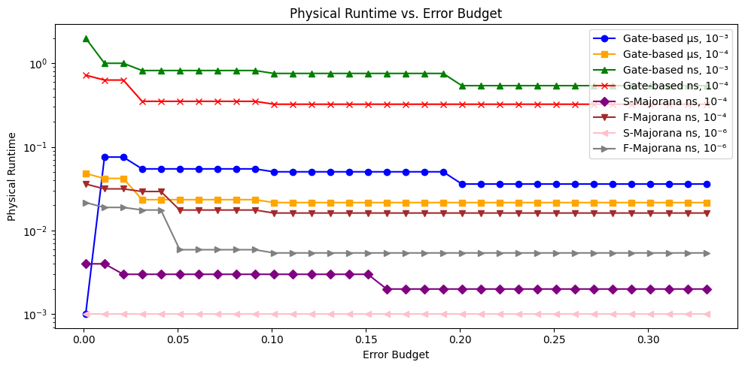
Determining the optimal trade off between Performance and Error Budget
The Graphs show a comparison of the Error Budget VS
1.The number of Physical Qubits required
2.The T Factory Fraction %
3.The Physical Run Time
Notes:
We ran a test comparison for the jobs, comparing the Number of Physical Qubits, the Physical Run time, the T Factory Fraction Percentage, as well as additional parameters, all against the range of error rates
our results not only confirmed that the Gate_based ion quantum computer with the “surface_code” quantum error correction scheme is the best set of parameters to run our algorithm on, it also showed us that we can reduce the error budget from 33.3% to just above 9% and still achieve the same results
The Job in yellow is the job that we found performed the best.
Based on the Resource Estimator results, our recommendation to other attempting to solve a quadratic unconstrained binary optimization problem on Microsoft’s quantum software is that they use the ion based quantum computer with “surface_code” as quantum error correction scheme and an error rate budget of 9%
TFactory Fraction: 14.29 %
number of physical qubits needed:252
physical time required: 234 microsecs
number of Quantum operations that can be performed per sec: 10,000,000

Slide 10
Conclusion
We have successfully developed a working implementation of QAOA using Q# and Python.
Ran a comparison of various Quantum parameters and offered a data based recommendation of which values to use in order to optimize the success of QAOA
Created a project that can be used for benchmarking different optimization problems that use QAOA
Notes:
after choosing to focus on a number partitioning problem and learning how to implement it’s quantum circuit representation in Q# sharp, we successfully calculated the quantum resources needed to accurately partition a list of 3 variables into two lists with equal(or close to equal) sums.
and we are the first to apply Microsoft's resource estimator algorithm to a QUBO problem.
possible next steps if we had more time
Explore how the resource estimates change when the input list changes length (would the result be linear? exponential?)
Explore resource estimates when we vary the number of layers in the QAOA circuit.
Determine a better split of our error budget between logical qubits, T States, and the Synthesis rotation gates. rather than just each gets a third.

Slide 11
Possible Next Steps
Explore how the resource estimates change when the input list changes length (would the result be Linear? Exponential?)
Study why incorrect partitions of our QAOA circuit have varying probabilities
Explore resource estimates when we vary the number of layers in the QAOA circuit
Determine a better split of our error budget between logical qubits, T States, and the synthesis of rotation gates. Rather than splitting it equally.

Slide 12
THANKS!
Presented by the Qu-Cats
Special thanks to Qrise and Microsoft for supporting this project

Slide 13
Reference
[1] Lotshaw, P.C., Nguyen, T., Santana, A. et al. Scaling quantum approximate optimization on near-term hardware. Sci Rep 12, 12388 (2022). https://doi.org/10.1038/s41598-022-14767-w.
[2] Edward Farhi, Jeffrey Goldstone, and Sam Gutmann. A Quantum Approximate Optimization
Algorithm. arXiv:1411.4028 [quant-ph], (arXiv:1411.4028), November 2014.

